Slide 1
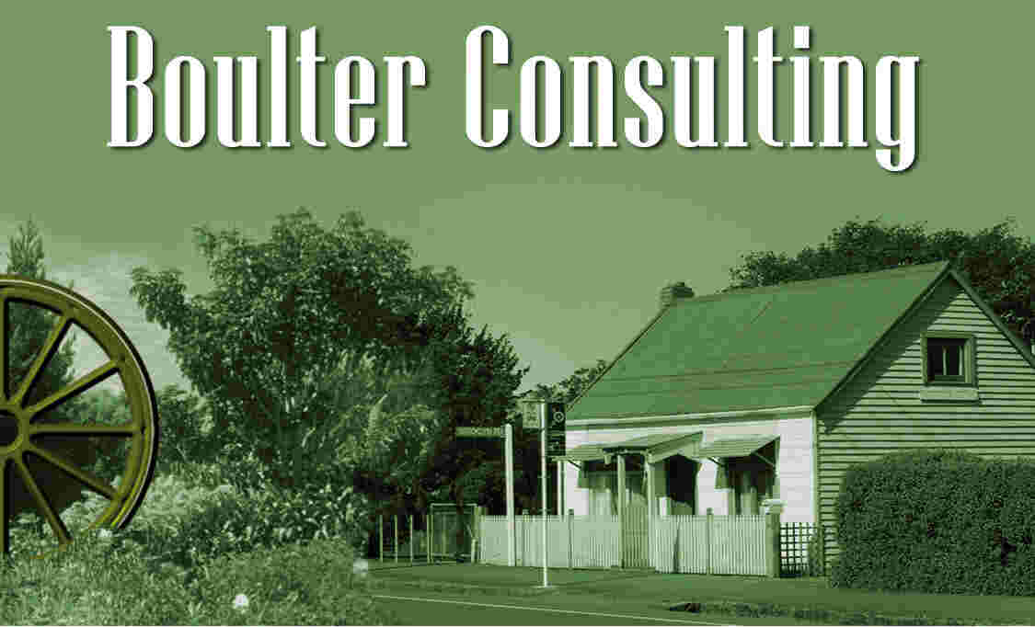
Planning for cycling
Waikato Sunrise Rotary Club
5th February 2016
Roger Boulter, BA (Hons), CMILT
Boulter Consulting
urban & transport planning

Slide 2
Scope of presentation
Approaching as transport planner
Can only plan for cycling as part of wider transport planning
Old-timer in this field – since 1982
Topical – what’s happening in NZ
‘Live’ issues – positive yet controversial

Slide 3
A bit about me
Urban and transport planner
UK urban and regional planning degree, professional jobs in UK (plan making, development control, etc), then transport
Last five years in UK (1990-95) ‘Cycling Officer’ Birmingham City Council (full-time)
1995 migration to NZ, clued-up on RMA, District Plan work, MNZPI, then
transport (Hamilton CC)

Slide 4
A bit about me
Planning for cycling caught up with me in NZ
‘Into The Mainstream’ 2000 while at HCC transportation policy planner job
Consultancy beckoned – jumped in 2003
2006 move to Wairarapa (family reasons)
Work areas transport & urban form, academic lecturing, government funding processes & criteria, regional rail – and cycle
planning & cycling strategies

Slide 5
Planning for cycling – beginnings
1930s Germany – motorways and cycleways
‘Fast modes’ and ‘slow modes’ – hierarchies
Applied to human race = holocaust
Applied to transport = ‘road hierarchies’
First ‘cycleways’ opposed by cyclists – implication “we are inferior”
But taken on by 1960s post-war ‘new towns’
‘Segregation ideal’ – cf Stevenage,
Milton Keynes, Canberra

Slide 6
Oil & environmentalism
1970s ‘oil shocks’ & ‘green’ movements
1977 Geelong Bike Plan
‘Four E’s’: “engineering, education, enforcement, encouragement”
All about children (1970s) & road safety
‘Cycle route networks’ (‘back street’, off-road) – but couldn’t match roads in
quality (or sometimes safety)

Slide 7
Breakthrough – integration vital
Breakthrough: 1996 “Five Point Hierarchy of Measures” UK IHT et al
First reduce traffic volumes; second reduce traffic speeds; then allocation of road space, intersections, with cycle lanes and paths lowest in priority
Opposite of what people had thought, and also more difficult than
‘building cycleways’

Slide 8
New Zealand developments
My ‘Into the Mainstream’ report of great interest to post-1999 government
2005 National Walking & Cycling Strategy
2004 Cycle Network & Route Planning Guide
National Land Transport Fund money for cycling (2002)
Local ‘cycling strategies’

Slide 9
“Integration” in transport planning
1930s traffic modelling (Chicago) – forecast traffic growth & where it would want to go
This has been the foundation of transport planning ever since
Has become much more sophisticated since 1930s
‘High point’ was 1960s – 1963 UK ‘Buchanan report’ followed by urban area
studies (Hamilton 1970)

Slide 10
“Integration” in transport planning
Public transport added in late 1980s/ early 1990s – as ‘alternative’ to the car
Planning for cycling still a ‘backwater’ from all this (1977 Geelong Bike Plan etc)
“Five Point Hierarchy of Measures” provides potential for integration – but has it been applied?
“Road user hierarchy” (York, UK) – nice concept, but again has it been applied?
Answer:
sometimes overseas, not much in NZ

Slide 11
More recent NZ developments
2008 John Key announces ‘NZ Cycle Trail’ as part of post-economic-crisis ‘jobs summit’
“But I thought you had to be a left-wing greenie to like cycling?”
Cycling’s image has changed radically – “the new golf”
Higher-income rather than
lower income?

Slide 12
More recent NZ developments
2014 Cycling Safety Panel (responding to crashes)
2014 Urban Cycleways Fund – boost total spending (inc local Councils) from about $100M to about $300M
National Cycling Team at NZTA

Slide 13
“Been there, driven that”
Major move (internationally and in NZ) away from the car since mid-1990s
Transport planning innovations have almost all been in alternatives: high-speed trains, urban rail; trams; ‘transit-oriented development’; urban design/ ‘people-spaces’; planning for walking
Total travel, and adolescents
driving tests, static/ declining

Slide 14
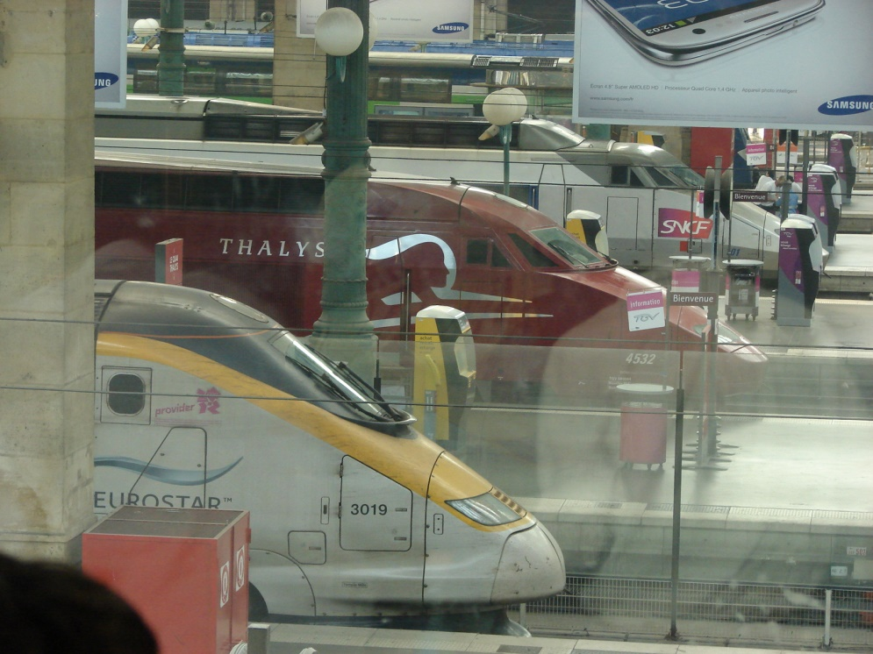
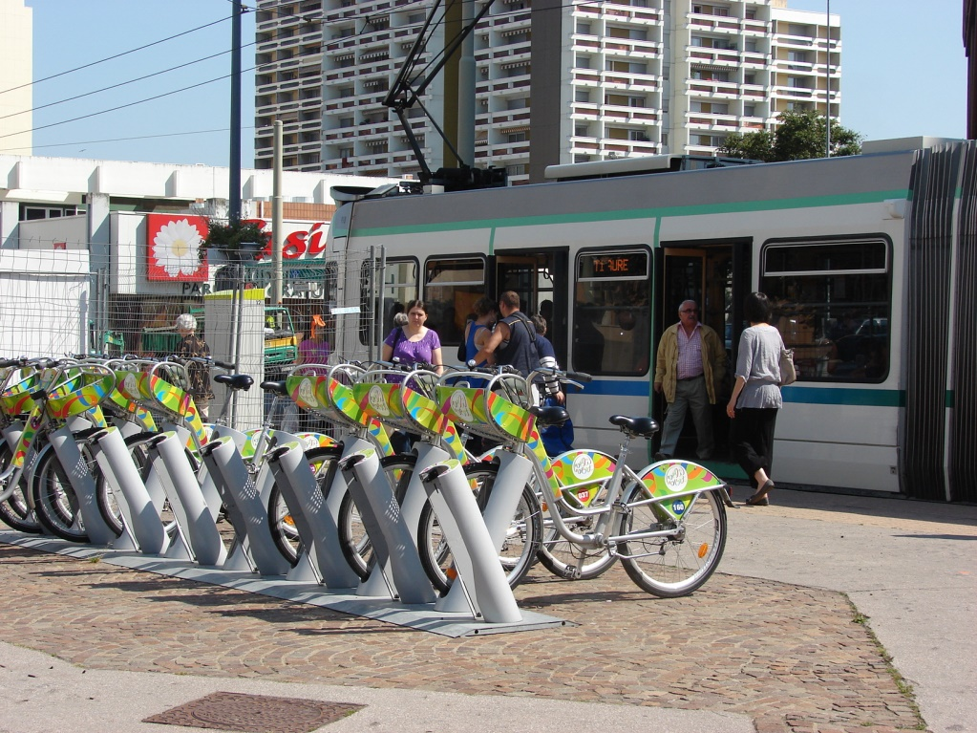
The fruit on the ground: rail
Paris & St Etienne, France

Slide 15
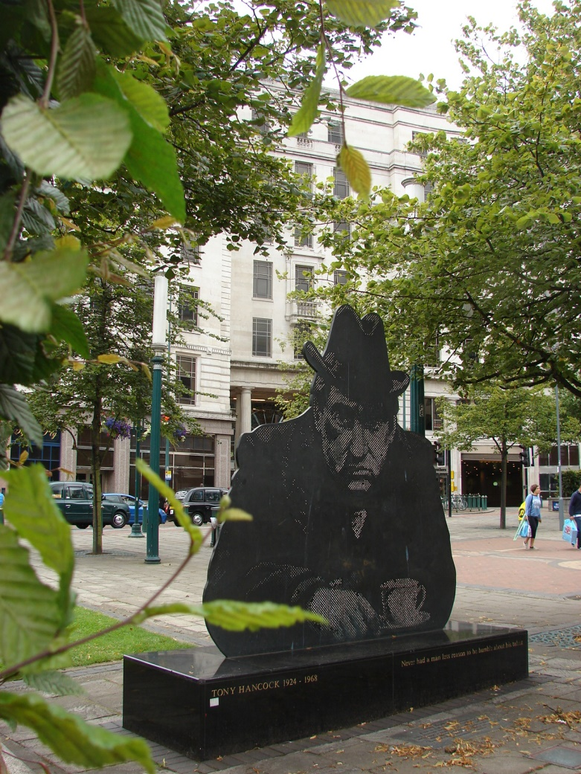
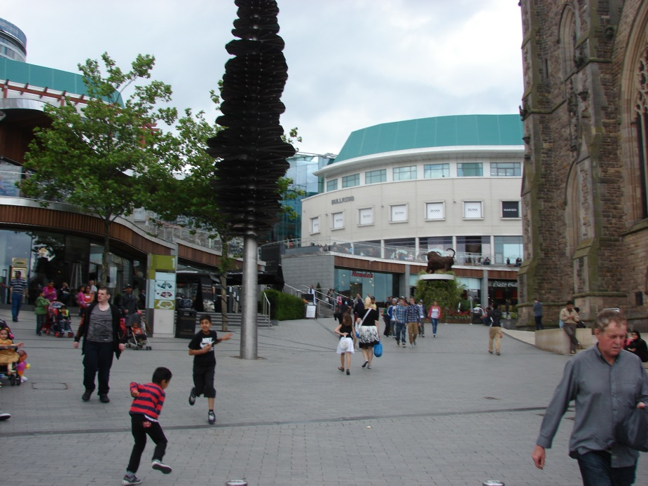
The fruit on the ground: international
1960s: build motorways; early 2000s, remove them
              Old Square &
              St Martins,
              Birmingham

Slide 16
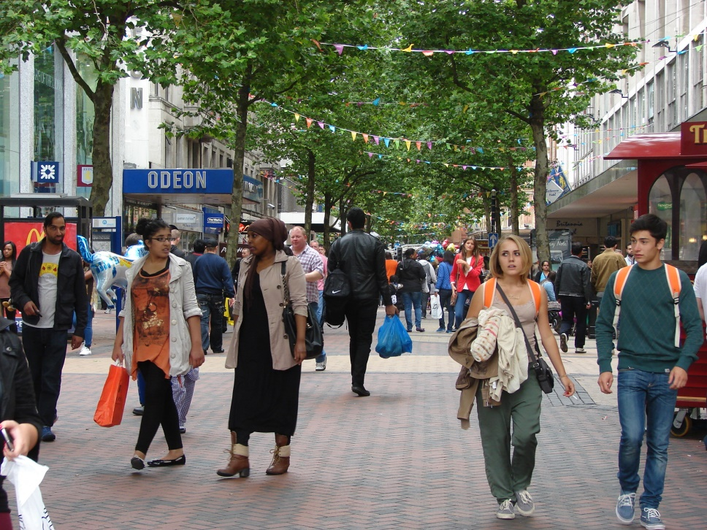
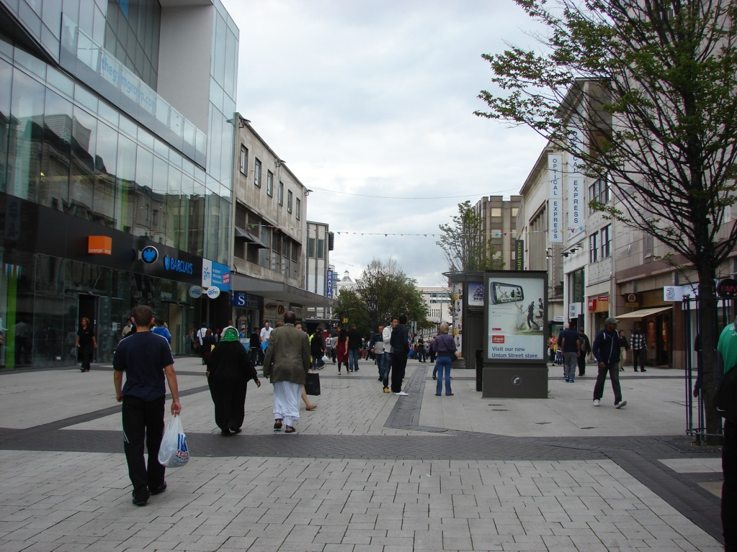
The fruit on the ground: international
Birmingham pedestrian
spaces: New Street &
High Street

Slide 17
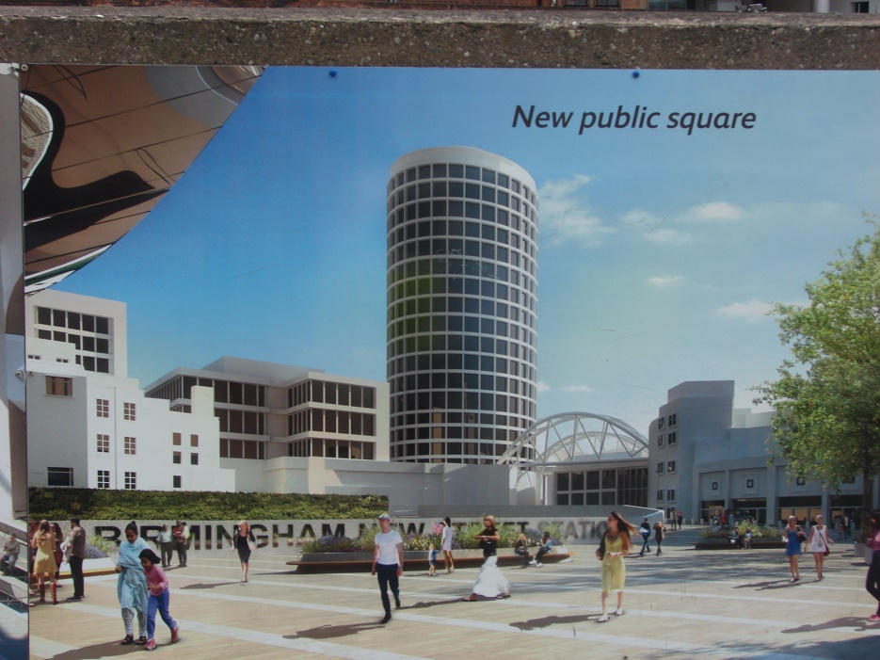
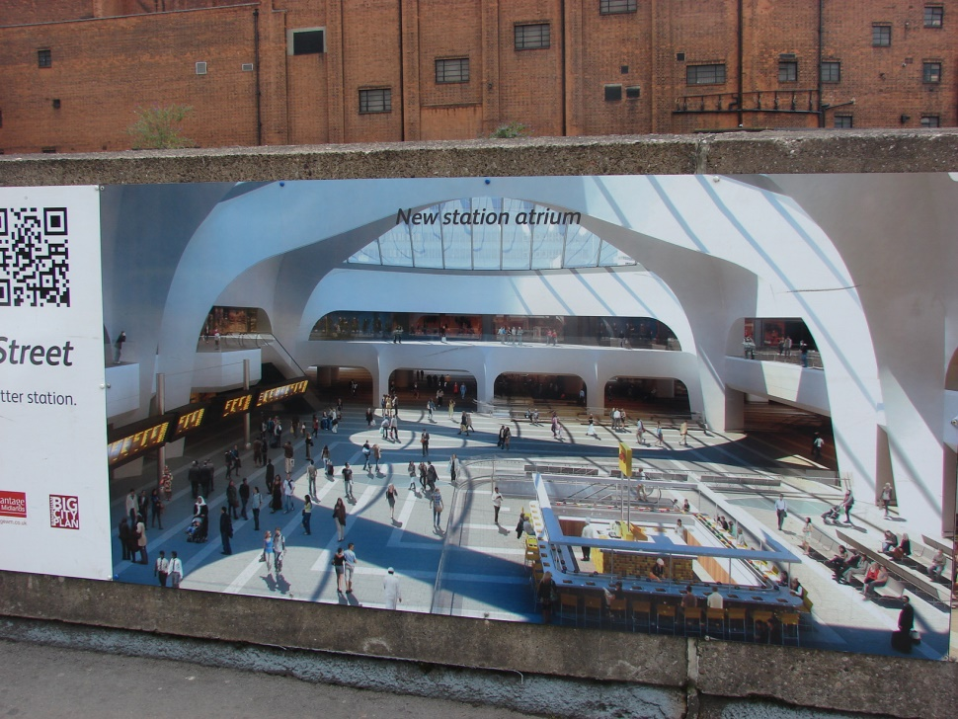
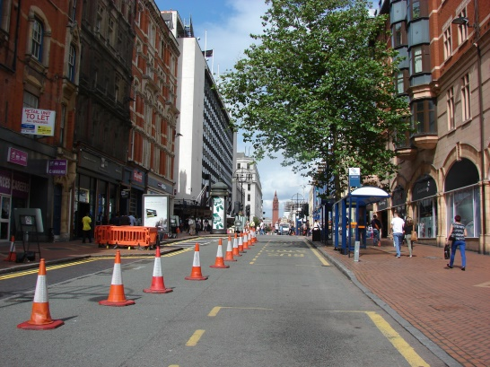
The fruit on the ground: rail (soon)
New Street station; Corporation Street light rail, Birmingham UK

Slide 18
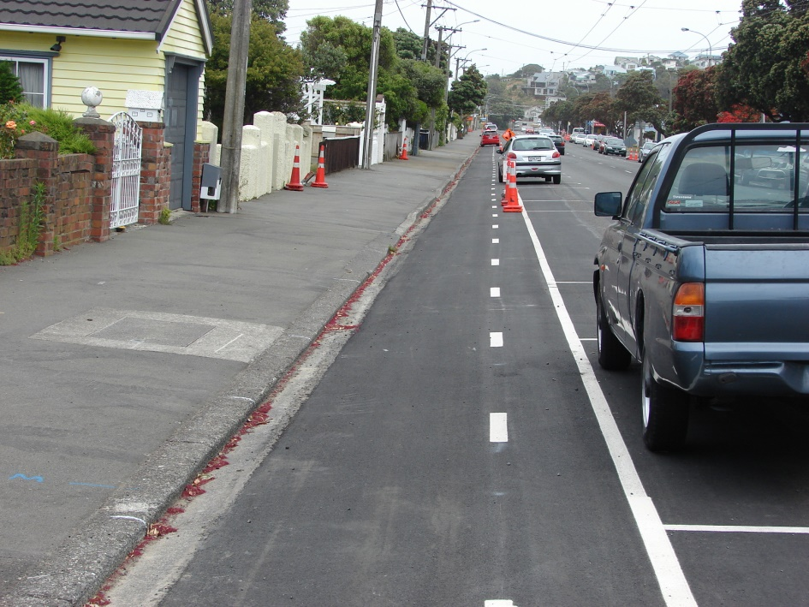
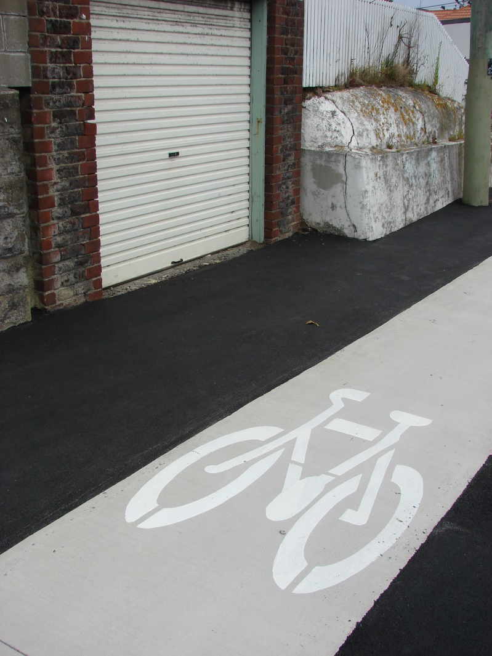
The fruit on the ground: New Zealand
Island Bay, Wellington

Slide 19
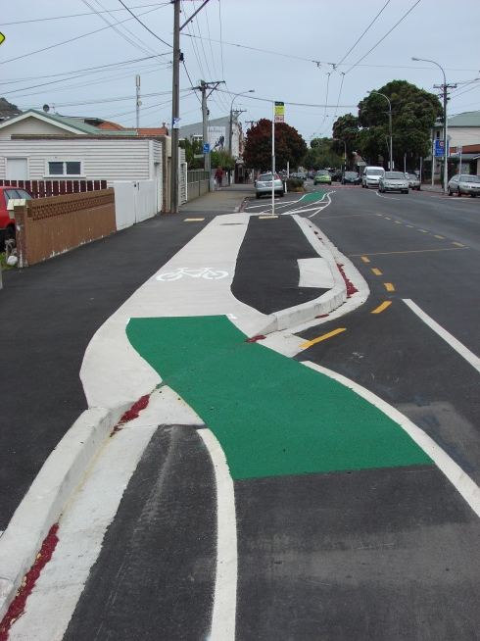
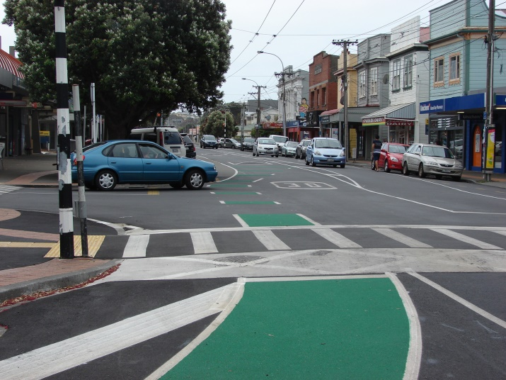
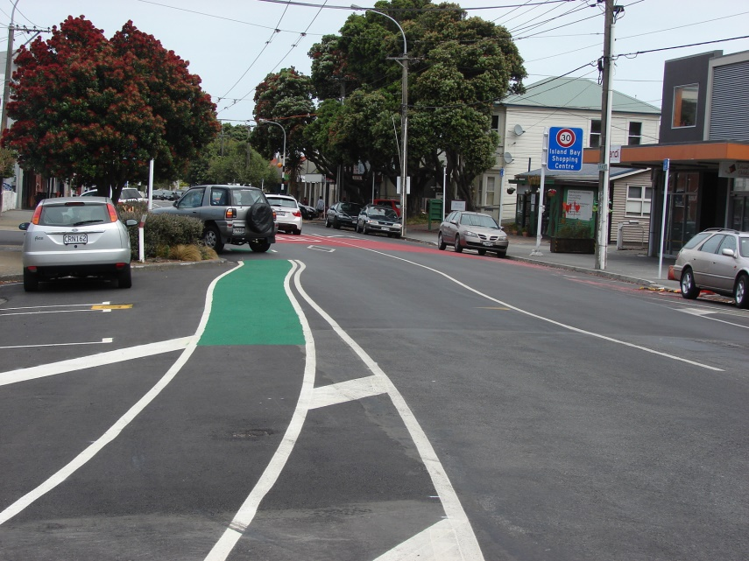
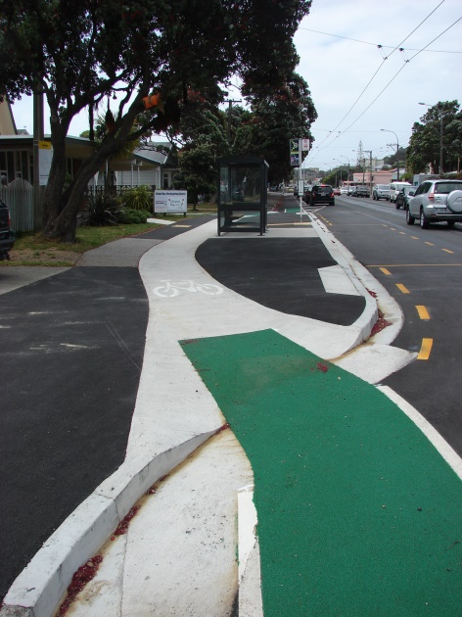
The fruit on the ground: New Zealand
Island Bay,
Wellington

Slide 20
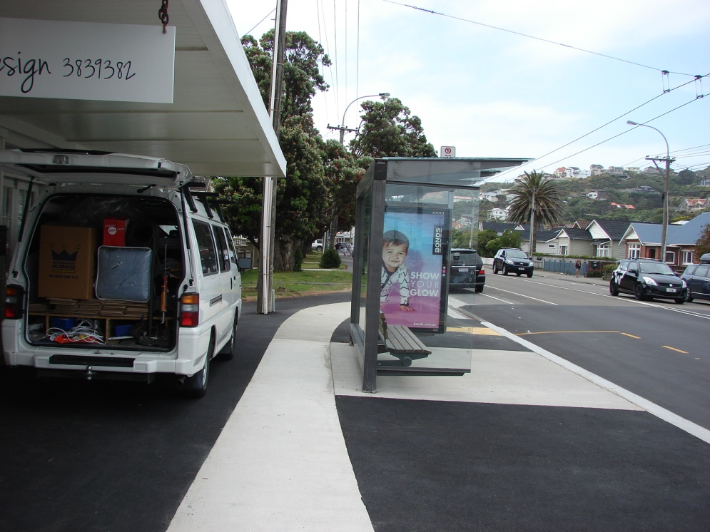
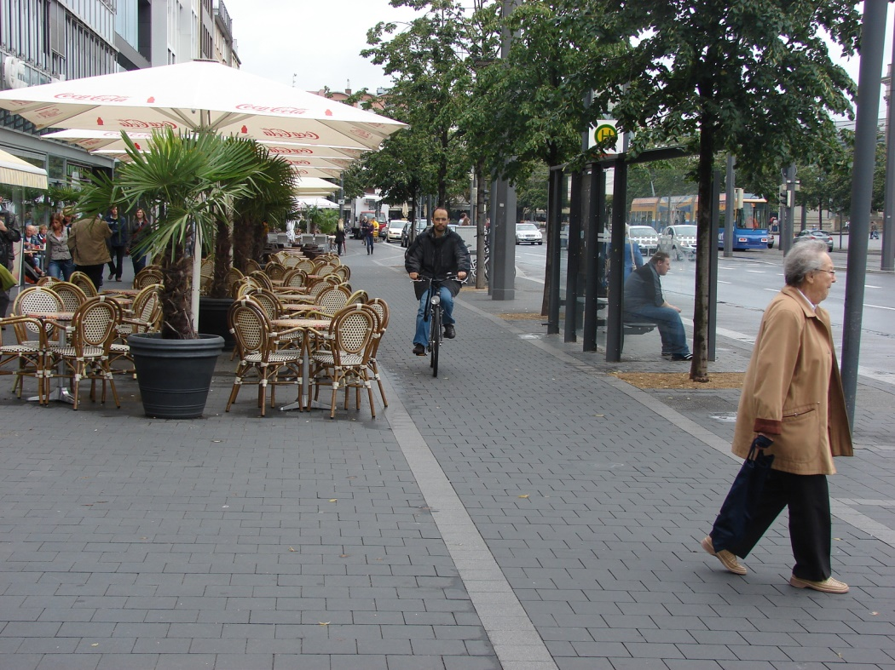
It works overseas – will it in New Zealand?
Island Bay, Wellington
Braunschweig, Germany

Slide 21
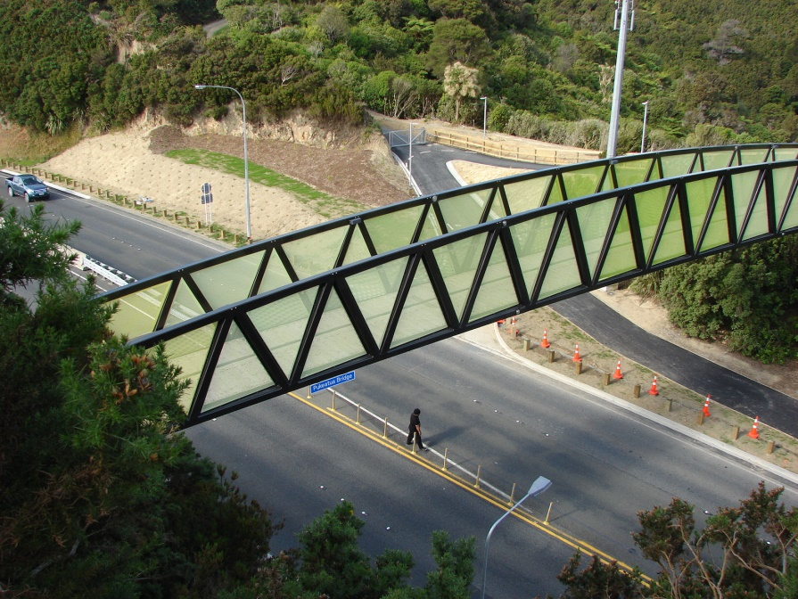
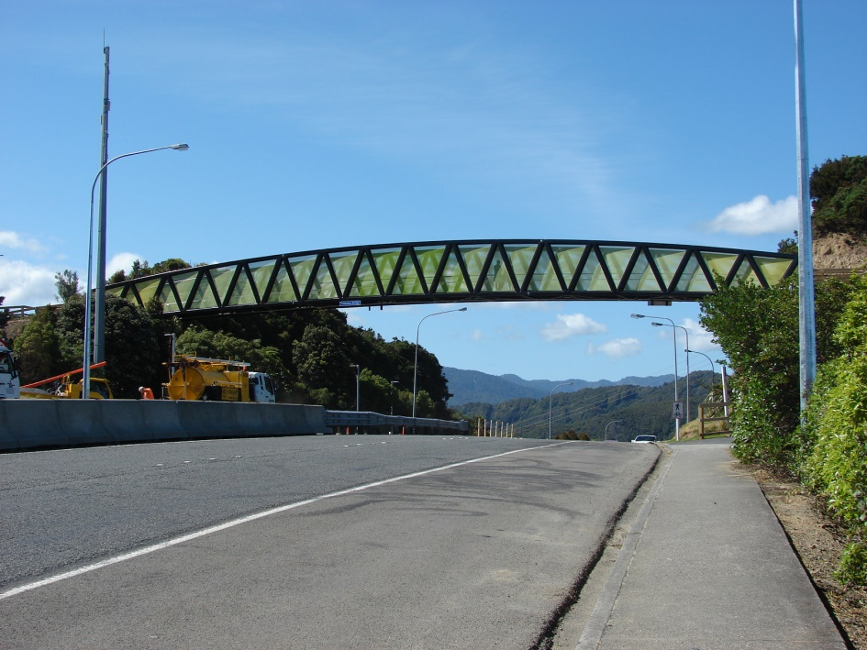
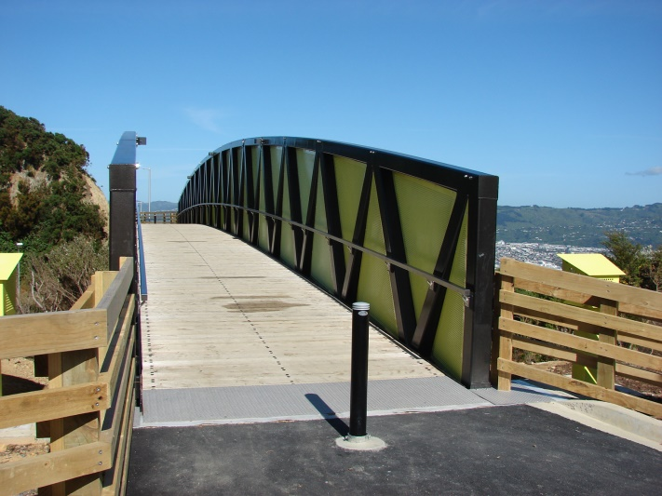
The fruit on the ground: New Zealand
Wainuiomata Hill Road

Slide 22
Challenges: MoT & strategy
Ministry of Transport: recognise move from the car, but technology a major focus (driverless cars, Uber, etc).
Address walking & cycling; Government “does not favour” the 2005 NWCS (previous government) – but the only strategy NZ had, so build on it.

Slide 23
Challenges: MoT & NZTA
MoT the ‘thinkers’, NZTA the ‘doers’
Early 2000s, MoT led the strategy (NWCS), NZTA [predecessor agencies] put it into practice (e.g. CN&RPG) – logical & how it should be
MoT strategic thinking needed, to guide NZTA ‘building cycleways’ etc (need to think about how this fits in with other
transport planning & funding).

Slide 24
Challenges: the right actions?
NZTA reactive (Cycling Safety Panel), infrastructure- and engineer-led.
Many NZTA-funded cycleways are ‘nice to haves’ (because of need to ensure budget is spent, so build what is ‘ready to go’).
Even the famous Auckland Central Motorway Junction cycleway bridge may have personal safety issues (no ‘escape’).
(cf London’s Hungerford Bridge)

Slide 25
Challenges: cycling & road traffic
Most cycling will take place among road traffic
Obvious – need to address this
Most of any journey on any new ‘cycleway’ will involve some cycling on general-purpose roads – hence mid-1990s shift to addressing the motor traffic
So ‘cycleways’ just ‘icing’ – more
important “what’s in the cake?”

Slide 26
Challenges: cycling & road traffic
Cycling skills within traffic – big need for education
Similar to driving instruction – on-road coaching
John Franklin ‘Cyclecraft’ (UK), John Forester ‘Effective Cycling’ (USA) – both 1980s, vital, with prestigious endorsement (UK MoT & USA MIT respectively) – needed in NZ
Also, how motorists respond to
cycling (AA has been supportive)

Slide 27
Conclusion
MoT: embrace walking & cycling as part of response to people’s move away from the car
MoT: dust off 2005 NWCS & review it
NZTA: translate reviewed NWCS into practice (carefully-thought-through mix of measures – not just infrastructure + promotion)
NZTA: cycling should be
integrated with mainstream

Slide 28
Forthcoming book
Motive 2014: A lot at risk of being lost
Added motive 2015: avoid mistakes made in the past
Cycling will probably increase (immensely popular, positive public image – unlike 1980s)
But new cyclists could become crash statistics as they mix with traffic
Road sharing education needed.

Slide 29
Book: progress to publication
First draft written late 2015
First draft professionally peer-reviewed end 2015
First draft revision this month
I am exploring publication options now (have a ‘default’ publisher)
For ‘interested lay’ more than ‘professionals’
Some have said my message is
much needed – wish me well!

